Slide 1

Project Title – SEASONAL AGRICULTURAL PERFORMANCE ANALYSIS
NAME : HARSHVARDAN G D
COLLEGE NAME : SRI SAIRAM INSTITUTE OF TECHNOLOGY
AICTE STU ID : STU6a2a2a51ce5761781148241

Slide 2

PROBLEM STATEMENT
Agricultural activities are influenced by seasonal variations in environmental conditions, farming practices, resource availability and market conditions.
As a result, agricultural performance may differ from one season to another. However, raw agricultural data does not clearly explain how agricultural performance changes across seasons or what patterns can be observed in different seasonal conditions.
The problem is to analyze the given agricultural dataset and investigate seasonal differences in agricultural performance by identifying meaningful patterns, trends, relationships and variations within the available data.

Slide 3
Project Description
This project analyzes seasonal agricultural performance using a dataset of 4,000 farm records spanning 8 Indian states, 10 districts and 8 crops across the Kharif, Rabi and Zaid cropping seasons.
Using Python (pandas, seaborn, matplotlib, sciPy), the project cleans the raw data, compares yield, revenue, profit, water-use efficiency and disease/pest risk across seasons, and statistically tests whether these seasonal differences are significant.
It further examines how environmental conditions, irrigation method, crop choice and state-level geography drive performance. The output is a set of evidence-based insights and season-specific recommendations for farmers, policymakers and agri-advisory bodies, fully documented in an executed Jupyter Notebook.

Slide 4

WHO ARE THE END USERS?
Farmers & Farm Managers – to plan sowing and irrigation by season: Kharif offers the best average yield and profit but the highest disease/pest risk (54.5%), while Zaid needs the most caution (average profit is negative).
Agricultural Policy Planners / Government Departments – to target subsidies and irrigation support toward the Zaid season, where only 35.5% of farms are profitable.
Crop Insurance & Agri-Risk Assessment Firms – to price risk using season- and region-specific loss data, since close to half of all farms in the dataset operate at a loss regardless of season.
Agricultural Extension & Advisory Officers – to recalibrate pesticide guidance by season, since Kharif's disease/pest risk is far higher than Rabi or Zaid but pesticide use is flat across all three.
Irrigation Planning Agencies – to promote drip irrigation, which this analysis found to be the most water-efficient method across every season.

Slide 5

Technology Used
• Python — core language used for all data cleaning, analysis and visualization.
• pandas & NumPy — data loading, cleaning, group-by aggregation and numerical computation.
• Matplotlib & Seaborn — bar charts, boxplots and heatmaps used across the analysis.
• SciPy (stats) — Used for ANOVA and Kruskal-Wallis statistical tests.
• Jupyter Notebook — literate, reproducible documentation combining code, output and commentary.

Slide 6
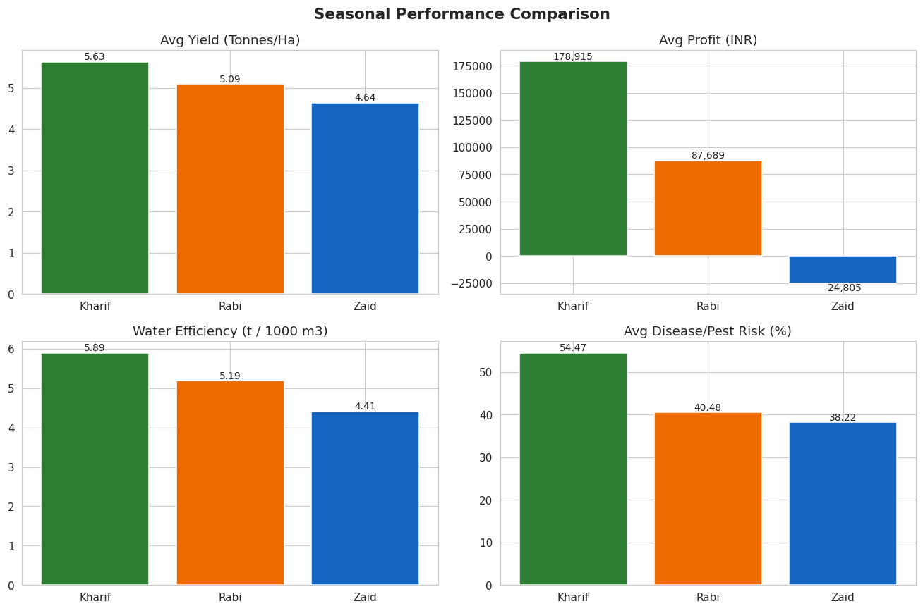
RESULTS
• Kharif records the highest average yield at 5.63 tonnes/hectare, ahead of Rabi (5.09) and Zaid (4.64).
• Average profit follows the same order: ₹178,915 in Kharif, ₹87,689 in Rabi, and a loss of -₹24,805 in Zaid — the only season with negative average profit.
• Water efficiency is also highest in Kharif (5.89 t/1000m³), dropping to 4.41 in Zaid.
• Disease/pest risk is inverted: Kharif's 54.5% is well above Rabi (40.5%) and Zaid (38.2%), so the strongest season is also the riskiest for crop health.
• Overall, Kharif is the strongest season economically, but that strength comes with a real pest/disease trade-off.

Slide 7
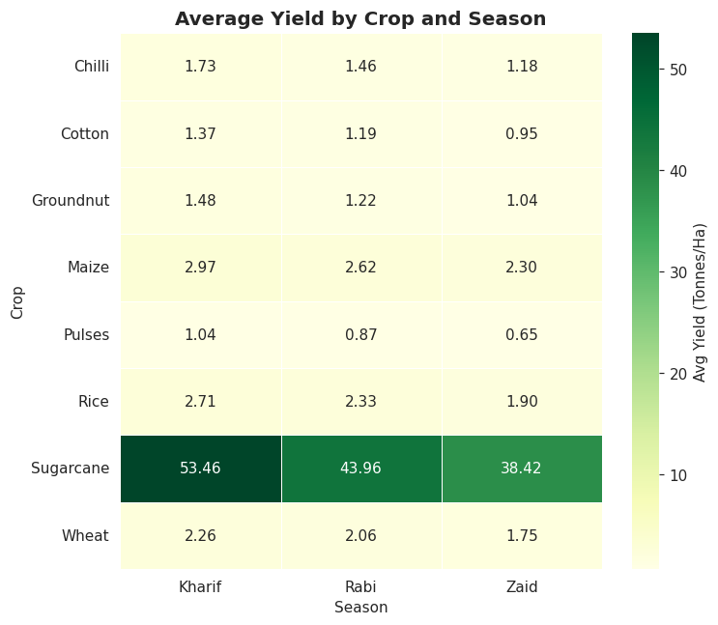
RESULTS
• Every crop's yield is highest in Kharif and lowest in Zaid, with no exceptions — all 8 crops follow this order.
• Sugarcane dominates in absolute terms, yielding 53.46 t/ha in Kharif versus roughly 1–3 t/ha for most other crops.
• The Kharif-to-Zaid gap is proportionally similar across crops (roughly 25–35% lower in Zaid), pointing to a consistent seasonal effect rather than a crop-specific one.
• Because the pattern holds for every individual crop, it rules out the idea that Kharif's overall advantage is just due to which crops are grown more often in that season.
• This heatmap is the strongest single piece of evidence that season — not crop mix — drives the yield gap.

Slide 8
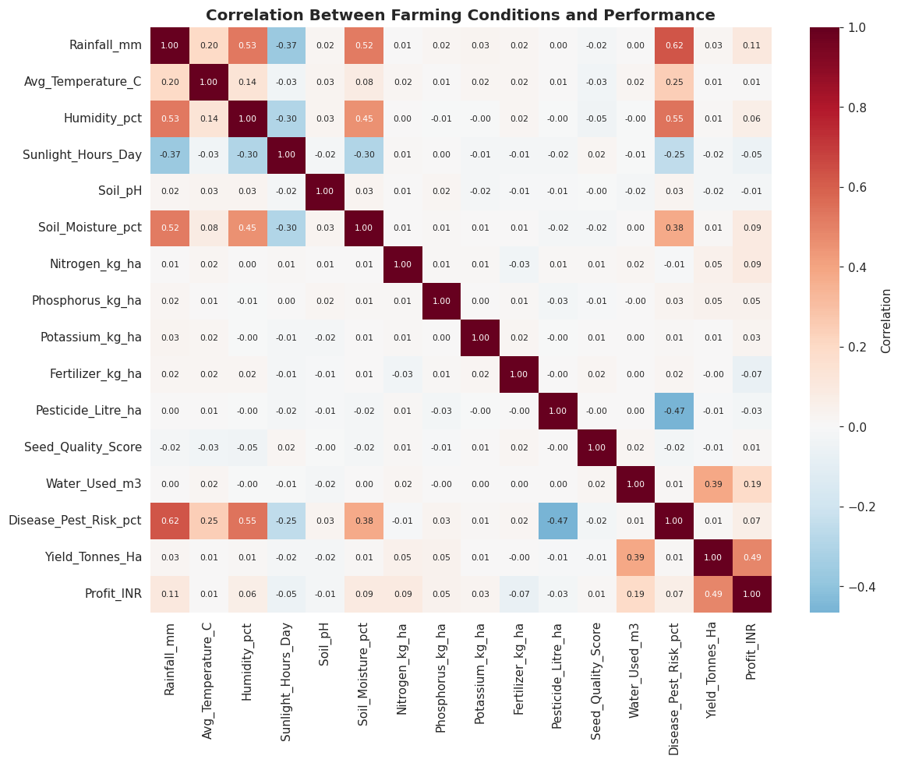
RESULTS
• No single environmental or input variable correlates strongly with yield alone — every coefficient against Yield (Tonnes/Ha )is below ±0.06.
• Disease/pest risk correlates strongly with rainfall (0.62) and humidity (0.55) — both of which peak in Kharif.
• Pesticide use has a negative correlation with disease risk (-0.47), but this doesn't fully offset Kharif's elevated risk, since pesticide use itself doesn't rise in Kharif.
• Profit correlates moderately with yield (0.49) and water used (0.19), showing higher-output farms are generally more profitable, though not perfectly.
• The weak yield correlations confirm crop choice — not environmental conditions — is the main driver of yield, matching the crop-heatmap finding.

Slide 9
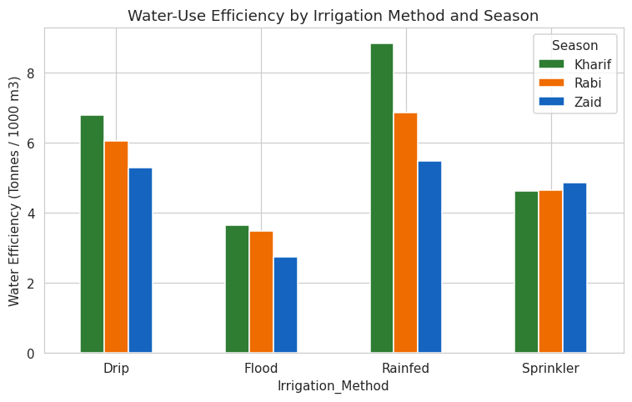
RESULTS
• Drip irrigation is the most water-efficient method among the actively-irrigated types, in every season.
• Efficiency for every method declines from Kharif to Zaid, consistent with Zaid's higher temperatures and evaporation losses.
• Flood irrigation is the least efficient method in all three seasons, making it the weakest choice for water-scarce regions.
• Rainfed shows an unusually high score, but that's because its water-used figure only counts supplemental irrigation, not rainfall itself — so it isn't a like-for-like comparison with the pumped methods.
• Among Drip, Flood and Sprinkler, Drip's advantage is largest in Kharif and smallest in Zaid, suggesting its water-saving benefit matters most in the wetter season.

Slide 10
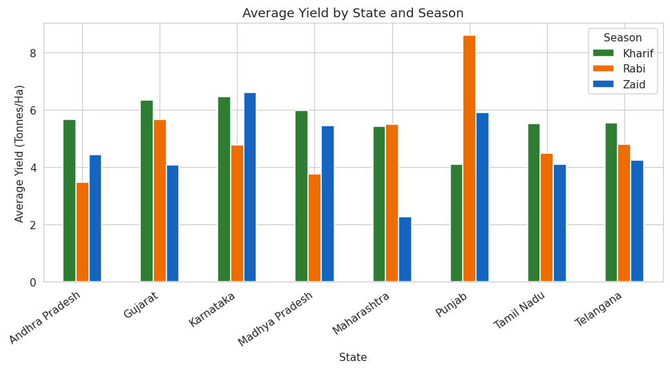
RESULTS
• 6 of the 8 states follow the same Kharif > Rabi ordering seen in the national averages.
• Punjab is the clear exception, where Rabi yield (8.6 t/ha) far exceeds Kharif (4.1 t/ha) — consistent with Punjab's real-world identity as a wheat (Rabi crop) belt.
• Maharashtra shows the smallest spread between seasons, suggesting more stable year-round conditions there.
• States like Karnataka and Gujarat show a much sharper Kharif advantage, meaning the seasonal effect isn't uniform in strength even where the ordering holds.
• Because the overall pattern holds in most states despite regional differences in what's grown, this supports treating the season effect as a genuine national trend rather than a fluke from one or two states.

Slide 11
Future scope
• Build a predictive model (regression / ML) to forecast yield or profit from season, crop and input variables.
• Incorporate real-time weather and satellite data for dynamic, location-specific seasonal recommendations.
• Develop a farmer-facing dashboard flagging high-risk periods with season-specific pesticide and irrigation guidance.
• Expand the dataset to more states and multiple years to test whether the seasonal pattern holds nationally and over time.
• Integrate market-price forecasting with yield predictions for combined agronomic + economic crop-planning advice.

Slide 12
GitHub Link
https://github.com/HarshvardanGD/Seasonal-Agriculture-Performance-Analysis

Slide 13
VOIS Course completion certificate -
Course name- Data Visualization

Slide 14
Thank you
.
.

